Slide 1
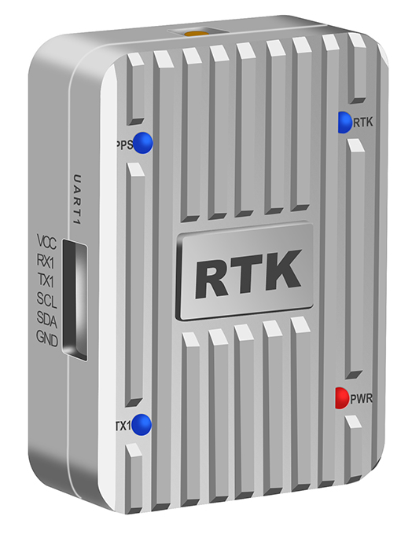

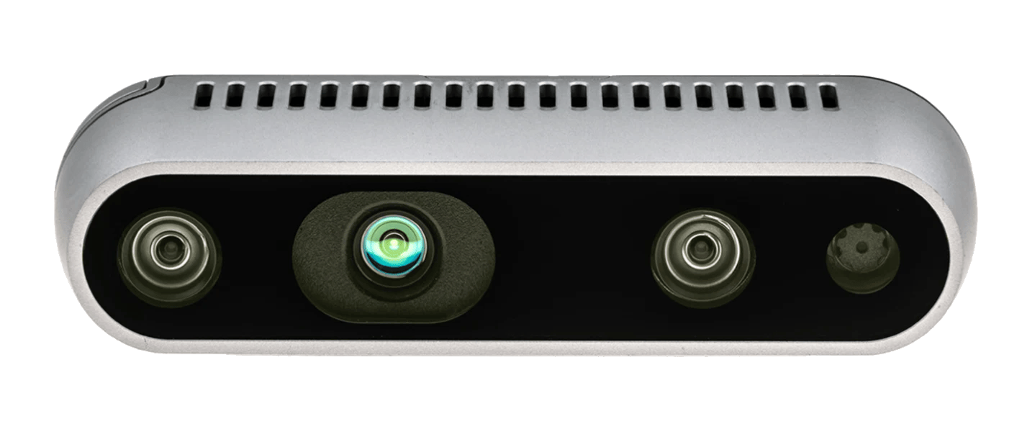

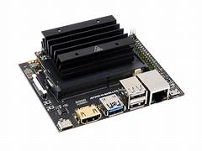
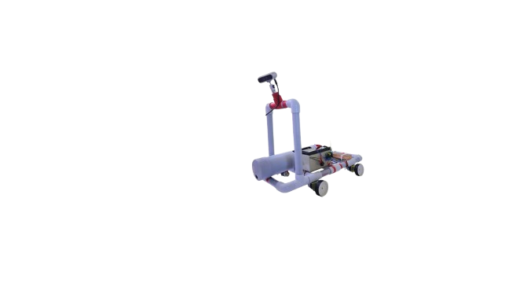
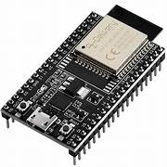
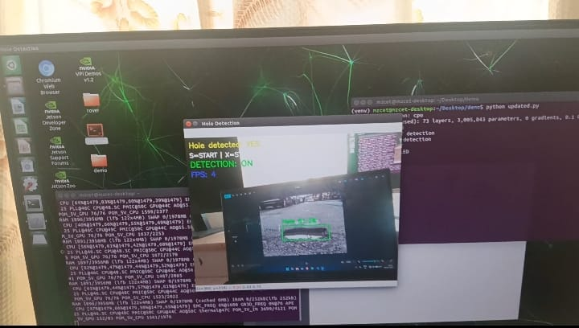
Train AI
Model
Using 400+
photos
RTK (GPS for
Autonomous
Navigation
Inputs video and sends frames
Jetson Nano
Processes the
entire Operation
Real Sense Depth Camera
d455f
Pothole Detection
Output
(Pothole Detected)
ESP32 controller
for Rover Movement
Road Bot

